Slide 1

Digital Interpreter

Slide 2
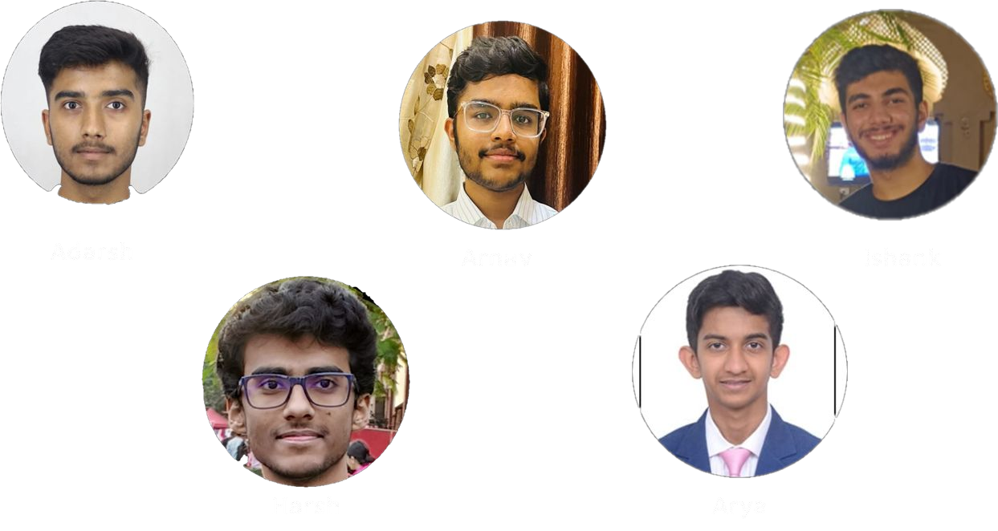
Our team

Slide 3
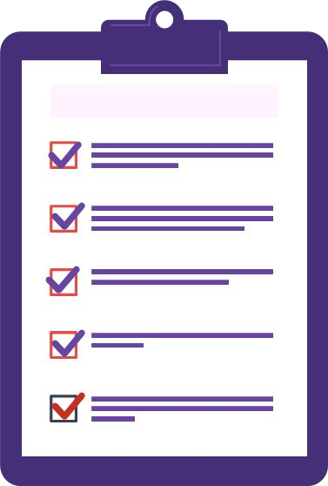
Problem statement
Develop an AI model for converting Indian Sign Language (ISL) to text and vice versa.
ISL to Text Conversion: Utilize a camera to capture and interpret ISL signs, translating them into text. Ensure the ability to convert the resulting text into any desired language.
Text Conversion to ISL: Allow users to upload a PDF or input text, enabling the system to read and interpret the text before translating it into Indian Sign Language.
Provide a comprehensive solution that covers both aspects of speech-to-text and text-to-speech for Indian Sign Language, incorporating features for various languages.

Slide 4








Tech stack
Sign-to-text
Text-to-sign
Moviepy
OpenCV
Mediapipe
NLTK
Flask
ReactJS
OpenCV
Mediapipe
Numpy
Tensorflow
Flask
ReactJS

Slide 5
Content:
Timeline
Sign-to-text converter
Text-to-sign converter

Slide 6
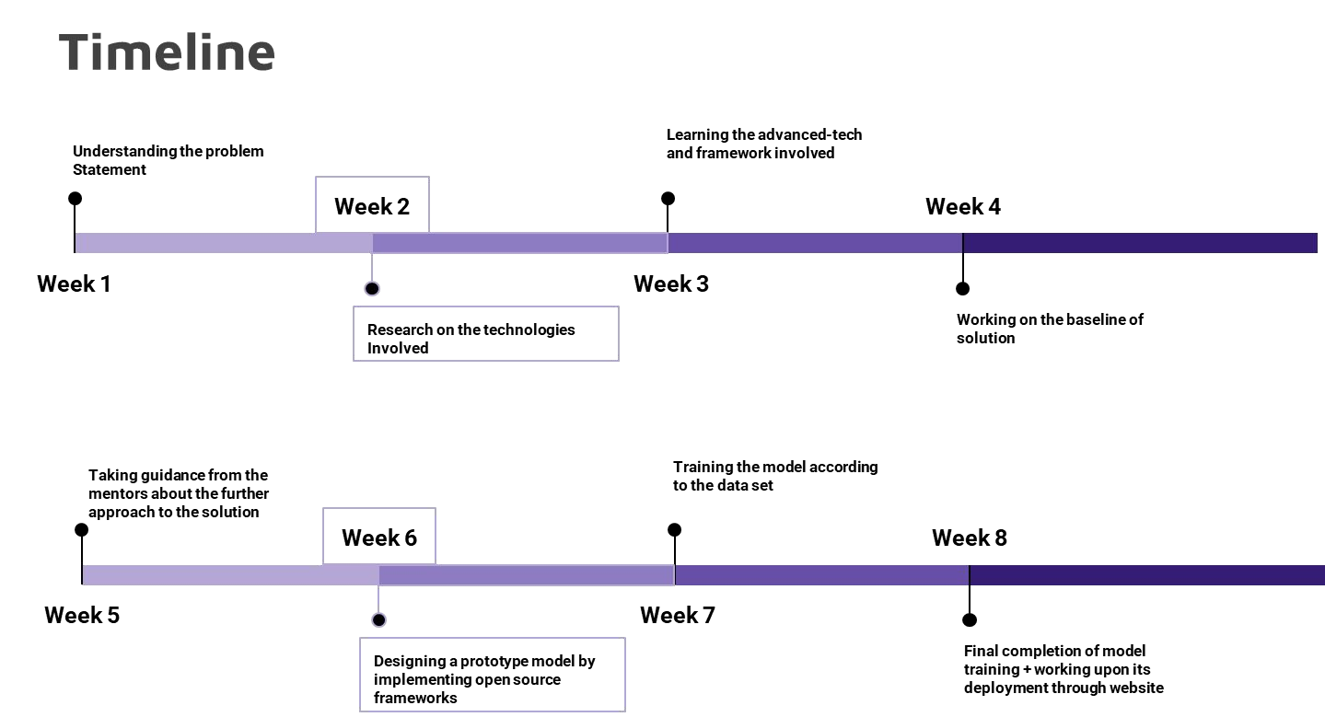







Slide 7
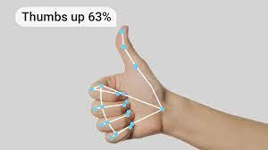
Sign-to-text

Slide 8
Approach
Existing implementations and approaches of the project include heavy image processing for model training. This reduces accuracy as it has a lot of garbage data and image dependent results.
We decided for a lighter and more resilient approach via the Mediapipe library
Appending predicted sentences to a text file.

Slide 9
Raw footage
Broken down into still frames
Mediapipe extracts features
 |  | Data in coordinat form in a numpy | e
 |  | array
Passed keypoints array to model for prediction
Flattened numpy array for all frames

Slide 10

Challenges
Generation of dataset
Backend integration due to requirement of real time response
Complexity of gestures
Overlapping similarity between some gestures
Architecture decisions
Time restrictions

Slide 11
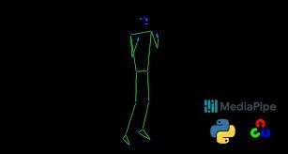
Text-to-Sign

Slide 12
Approach
Using the mediapipe library we created a skeletal figure to perform gestures.. We then created a dataset for limited vocabulary which is easily expandable.. Then using a mapping algorithm we break down a string input and map words to respective actions and the skeletal figure then performs the action.

Slide 13
Post Request
NLP
algorithm
 |  | Tokenized output
Mapping algorithm
Frontend
Output actions

Slide 14

Challenges
Time restrictions made it difficult to come up with a language parsing algorithm.
Creating dataset needed precision
Distinguishing between phrases which include pre-existing words

Slide 15
Scalability
Ǫuick generation of dataset for text to sign
Mapping speed is high and requires very little processing for text to sign
Since dataset need for sign to text is a numpy array it will take less space and save resources.
Lower processing for training the sign to text model means less time and resources required which increases the scalability
To increase scalability we can also design an android app to increase ease of access
Further incorporation of blender can lead to a more visually exciting output for text to sign

Slide 16

Demo

